Slide 1


Topological Sort
França Mac Dowell
Lucas Ribeiro Raggi
Nelson Gomez Neto
https://github.com/NeRaFr-Huffman/Huffman

Slide 2
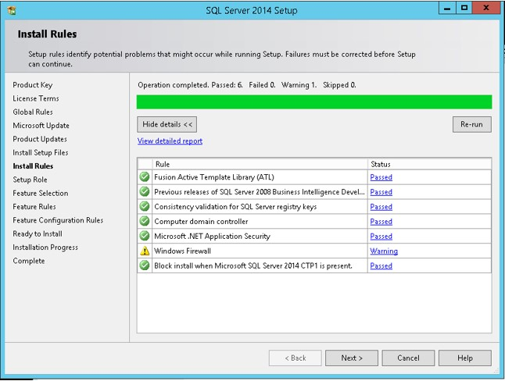
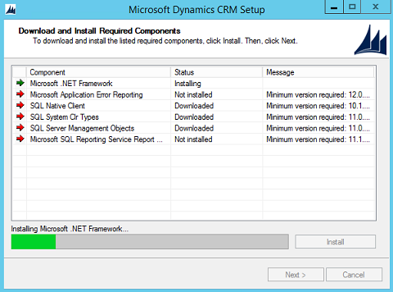
What if we needed to install a program with dependencies?

Slide 3
Using arrays
A
B
C
X
Y
Y depends on X and C depends on Y… how to represent?

Slide 4
Using Trees
A
B
C
D
E
F
If B also depends on F ?

Slide 5
Using Graphs
B
A
C
D
E
F
H
G

Slide 6
Topological Sort!

Slide 7
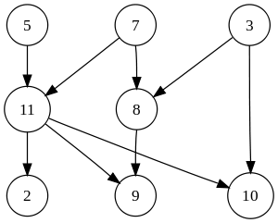
Topological Sort
Is a linear ordering of a graph vertices such that for every directed edge uv, vertex u will come before v in the ordering.
It’s not possible to sort if the graph is not a DAG.
Mainly used for scheduling jobs from the given dependencies among jobs.

Slide 8
Topological Sort
Differents implementations
DFS and BFS implementations
O(|V| + |E|)

Slide 9
C code(DFS):
void topologicalSort(graph_t *graph)
{
cleanVisits(graph);
for (i = 0; i < graph->size; i++)
if (!graph->visited[i])
sub_topologicalSort(graph, i, stack);
while (!isEmpty(stack)) {
(printf"%d\n", peek(stack));
pop(stack);
}
}
void sub_topologicalSort(graph_t *graph, int i, stack_t *stack)
{
graph->visited[i] = true;
adjList_t *curr = graph->vertices[i];
while (curr != NULL) {
if (!graph->visited[curr->item])
sub_topologicalSort(graph, curr->item, stack);
curr = curr->next;
}
push(stack, i);
}

Slide 10
B
A
C
D
E
F
H
G

Slide 11
Links to animation
DFS implementation : https://www.cs.usfca.edu/~galles/visualization/TopoSortDFS.html
BFS implementation: https://www.cs.usfca.edu/~galles/visualization/TopoSortIndegree.html

Slide 12
Applications

Slide 13
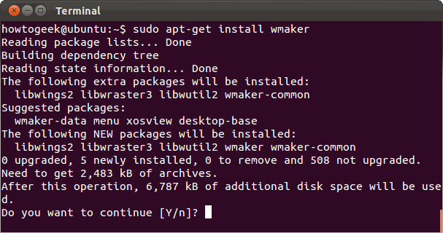
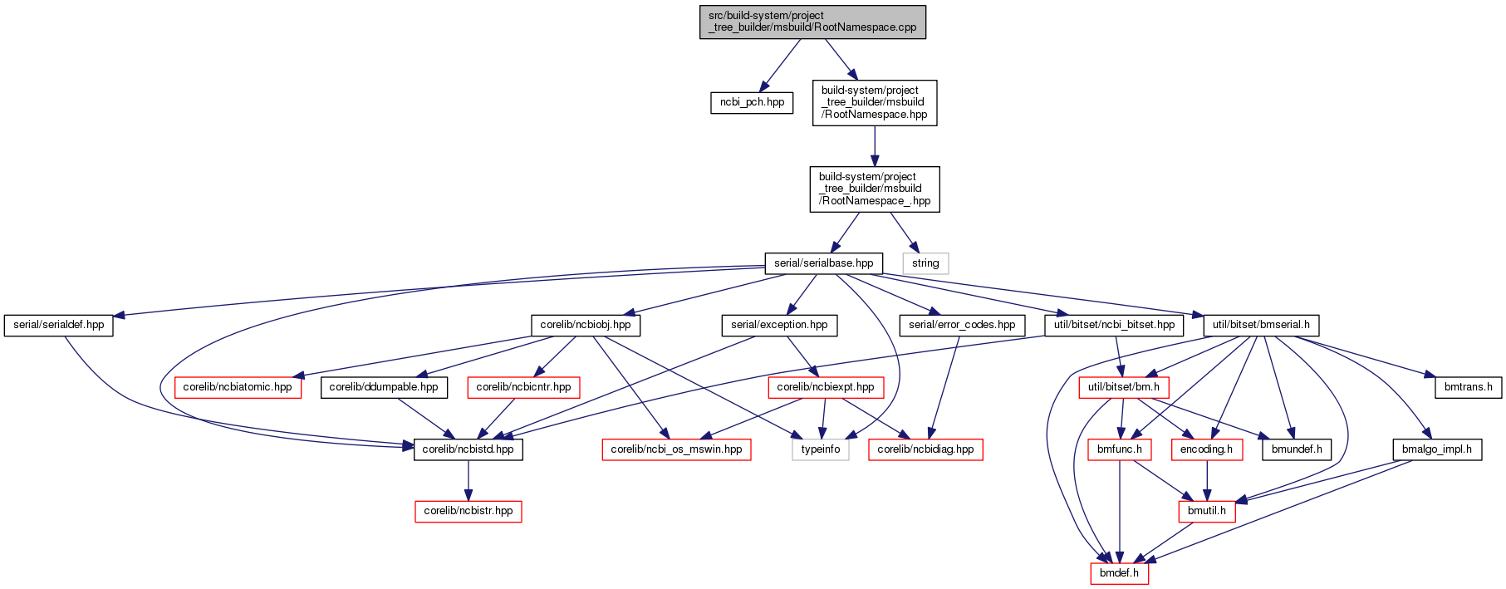
Advancing Packaging tool(apt get)
Build systems

